Slide 1
Token Optimization Services
Consulting Services
Cost discipline at AI scale.
Advanced AI Competency Center
06.02.2026

Slide 2
01
The Problem To Solve
02
TokenOps : Our Solution & Approach
03
Engagement Model
04
Client Credentials
05
TokenOps Levers

Slide 3
01 | The problem to solve

Slide 4
AI has entered its third wave: Token economics now determines whether it can scale.
Wave 3: Enterprises must focus on Token economics
Wave 2: Enterprises rush to drive AI adoption
AI usage is expanding faster than enterprises can forecast cost, attribute spend, control consumption, and prove value.
Wave 1: Enterprises work to integrate AI into workflows
How do I get my employees to adopt AI?
How do I get productivity out of AI?

Slide 5
AI adoption is working. The economics are unmanaged.
Usage is scaling across tools, APIs, and agents, but most enterprises cannot yet connect consumption to value, ownership, or runtime controls.
AI DEMAND
VALUE ATTRIBUTION
GOVERNANCE
AI usage scales nonlinearly, so spend outpaces forecasts.
AI no longer scales by seat count. It scales by workflow depth, context length, model choice, repeated prompts, and agent loops.
AI spend is visible. AI value is not.
Vendors bill by seat, token, model, and API call. But value shows up in workflow outcomes: cycle time, resolution quality, risk reduction, FTE leverage, and revenue conversion. Most enterprises cannot connect the two.
Controls arrive too late.
Budgets, model tiers, routing, caching, access controls, and agent stop conditions are often retrofitted after usage scales.
Implication: traditional SaaS budgeting and cloud FinOps miss the curve, turning successful adoption into bill shock.
Implication: leaders cannot tell productive investment from waste, so ROI looks weak even when AI is creating value.
Implication: leaders are left with blunt choices: restrict access, absorb runaway spend, or slow AI adoption.
$19B → $37.1B
>80%
Uber’s annual AI budget exhausted in ³
Growth in AI spend, 2024 to 2025 ¹
not seeing measurable KPI movement ²
4 months
Sources: 1. Gartner, 2. Mavvrik, 3. TechCrunch

Slide 6
AI cost drivers change with the adoption pattern, so optimization must be tailored.
Each dimension here contributes to leakage in some form. They must be understood and translated into a set of architectural and operational controls.
PATTERN A
PATTERN B
PATTERN C
AI as End User Tool
AI as Managed API
AI as Self-Hosted Infrastructure
Example:
Scaled copilot rollout across the enterprise.
Example:
Customer service agent resolving cases through frontier APIs
Example:
Private open-weight model running on cloud GPUs
Key Cost Drivers:
Key Cost Drivers:
Key Cost Drivers:
License waste
Token & context growth
Agent and tool sprawl
Model or plan selection
Billing path and vendor pricing shifts
Output and reasoning tokens
Long-context surcharge
Agent loops, tool overhead
Model selection & routing
Cache-miss economics
GPU compute and utilization
KV cache, throughput efficiency
Model size trade-offs
Inference software stack
DevOps and reliability
Notes:
Copy/paste notes:
Speaker Notes: Cost Driver Examples
Pattern A: AI as End User Tool
Example: scaled copilot rollout across the enterprise.
Unused seats: Some employees receive premium AI licenses but rarely use them. The company pays for broad access, but actual adoption is concentrated in a smaller group of active users.
Heavy user token demand: A small number of power users can drive a large share of consumption. They upload long files, ask multi-step questions, keep long chat histories alive, or use AI repeatedly throughout the day.
Agent and tool sprawl: End users start adding copilots, plugins, connectors, MCP servers, coding assistants, and workflow agents. Each tool feels small on its own, but together they create overlapping usage and unmanaged cost.
Model or plan selection: Employees may use a premium model or higher-cost plan for simple tasks like summarization, drafting, or classification. The task does not always need the most expensive model.
Billing path / vendor pricing: Costs can show up through different vendor paths: per-seat licenses, premium add-ons, API usage, marketplace tools, or enterprise agreement resets. That makes it hard to know whether spend is driven by adoption, pricing, or packaging.
Pattern B: AI as Managed API
Example: customer service agent resolving cases through frontier APIs.
Output and reasoning tokens:
The agent may spend tokens not just reading the customer issue, but also reasoning through policy, generating chain-of-thought-style intermediate steps, and drafting a long response. The answer may look simple, but the behind-the-scenes token path is expensive.
Long-context surcharge: The workflow may send the full customer history, policy documents, prior tickets, and knowledge-base content into the model every time. Even when only a small excerpt is needed, the model processes a large context window.
Agent loops, tool overhead: The agent may call multiple tools, retry failed steps, search again, re-rank results, or ask the model to validate its own answer. One customer case can quietly become many model calls.
Model selection and routing: Every request may default to a frontier model, even when a smaller model could handle routing, classification, extraction, or summarization. Without routing rules, expensive models get used for low-complexity tasks.
Cache-miss economics: The same policy text, system prompt, or reference content may be sent repeatedly instead of cached. When shared context is not reused, the enterprise pays again and again for the same tokens.
Pattern C: AI as Self-Hosted Infrastructure
Example: private open-weight model running on cloud GPUs.
GPU compute and utilization: The enterprise pays for GPU capacity even when demand is uneven. If workloads are spiky or poorly scheduled, expensive GPUs sit idle between bursts of usage.
KV cache and throughput efficiency: Long conversations and large context windows consume memory through the KV cache. If memory is not managed well, throughput drops and more GPU capacity is needed to serve the same demand.
Model size trade-offs: A larger model may deliver better quality, but it also requires more memory, more compute, and slower inference. Some workloads can meet the quality bar with a smaller or quantized model.
Inference software stack: The serving engine, batching strategy, cache implementation, and routing layer all affect cost. A poorly tuned inference stack can make self-hosting look more expensive than it needs to be.
DevOps and reliability: Self-hosting shifts cost into operations. Teams need monitoring, scaling, incident response, security, patching, latency management, and model updates. Those run costs need to be included in the economics.

Slide 7
02 | TokenOps: Our solution & approach

Slide 8
TokenOps takes AI from a cost question to a value engine.
Without slowing adoption.
From cost question to value engine.
Baseline Economics
Traditional Financial Planning, By Seat or SaaS-based.
Unit-Based Economics
Uber: 25% of my code is written by agents.
Google: 75% of new code is written by agents.
Value-Based Economics
25% more agentic code producing 25% more useful consumer features and 25% app subscriptions.
Accenture delivers TokenOps as a full optimization service, answering our clients’ biggest questions
■
Where is AI spend leaking today?
Accenture’s Token Optimization Services
■
Which workflows, users, models, and agents are driving waste?
■
Which controls can reduce spend without harming outcomes?
Methodology
5 steps
Technology
6 assets, 6 tools
Framework
3 dimensions, 5 levers
■
What must change in the architecture or operating model?
■
How should value be measured after implementation?
End-User
Managed API
Self-Hosted

Slide 9
We bring a multi-dimensional TokenOps Framework.
Each dimension addresses a pain point, translated it into controls, architecture changes, and operating routines. There are many levers here — a configurable portfolio, selected by context.
AI as End User Tool
AI as Managed API
AI as Self-Hosted Infrastructure
Seat, persona, and behavior economics
Variable unit-cost economics
Inference infrastructure economics
Optimization dimensions
Optimization dimensions
Optimization dimensions
User Insights
Task Optimizations
Model Optimizations
Segment the AI user and agent population. Identify automated pipelines driving disproportionate consumption.
Output trimming, prompt compression
Quantization, right-sizing, distillation, fine tuning
User Training
Application Optimizations
Inference Optimizations
Session Hygiene, Context Reduction, Targeted File Usage, Model Tiering, Batching
Tool usage, history management, batching, agent rationalization
Engine selection, batching, caching, speculative decoding
Auditing
Model Routing
Infrastructure Optimizations
Instruction files, tools, MCP servers, plugins, connectors
Task-based model and provider choice
GPU selection, containerization, autoscaling, parallelism
License Governance
Architectural Change
Application Optimizations
Consolidation, shadow management, right-sizing, phased rollout
Native caching, semantic caching, RAG service
Tool usage, history management, batch usage
Observability & Monitoring
Observability & Monitoring
Task Optimizations
Cost tracking, anomaly detection, budget alerting
FinOps instrumentation, cost attribution
Output trimming, prompt compression
Advanced Engineering
Model Routing
Fine-tuning, speculative decoding, prompt pre-processing
Task-based model and provider choice
Observability & Monitoring
FinOps, profiling, cost attribution
Notes:
Align the nomenclature to the next slide

Slide 10
These levers have demonstrated real outcomes
LEVER
WHAT IT DOES
ACCENTURE RESULTS
01
Usage Insights
Segment the AI user and agent population (dormant, low-usage, steady, premium-capped). Identify automated pipelines driving disproportionate consumption.
77,000+ AI/Data seats segmented via log audit.
"Who is using what, and should they be?"
Result at our Center for Advanced AI: 1,006 users analyzed. Top 100 drive 69% of token consumption (249B tokens / $472K over 4 months).
02
License Right-sizing
Mix flat-rate licenses with pay-as-you-go for low-usage seats. Reclaim dormant seats. Route premium-capped users through the gateway to a self-hosted model.
Evolved from $190/month flat-capped premium Claude licenses to multi-tier persona-based packaging.
"Is everyone on the right license?"
Result inside Accenture: Re-mix across 77,000-strong Data & AI population. Dormant reclaimed. Low-usage to PAYG.
03
Always-on Monitoring
Production telemetry across model, agent, tool-call, and infrastructure layers. Per-workflow budgets enforced at runtime. Anomaly alerts.
AI Control Plane deployed internally tracks 40 active models across 18 applications.
"Can I see cost and performance in real time?"
Result at a global bank (KYC-AML): 840M input + 2M output tokens saved daily. ~$20K/month on a single use case.
04
Model Fit
Live multi-provider intelligence. Task-aware routing. Sovereign inference for high-volume workloads. Premium frontier reserved for hard reasoning.
90% lower inference cost via Tier 1.5 Auto-Routing SOP. Gateway routes to open-weight with no workflow break.
"Am I using the right model for the right task?"
Result at a large telco: Re-routed agentic workloads via query caching + agent triage + dynamic chunking. $12M to $3.8M annual (70% input-token reduction).
05
Continuous Education
Curated patterns surfaced in the IDE and copilot. Prompt caching, progressive disclosure, LLM vs. SLM, inter-agent memory, self-hosted vs. managed.
AI Knowledge Repository serves the 77,000-strong Data & AI population.
"Do my people know how to be smarter with tokens?"
Result across mining and insurance: Caching pattern training. ~40% token reduction. ~$5K/month combined.

Slide 11
TokenOps features a 5-step iterative approach for value realization
The same phased playbook flexes by client maturity, data availability, and deployment pattern.
Evidence-led
Design-to-build
Value-realized
01
02
03
04
05
Foundation built to serve use case backlog
Baseline
Diagnose
Optimization design
Implement & tune
Scale, monitor & operate
ACTIVITIES
ACTIVITIES
ACTIVITIES
ACTIVITIES
ACTIVITIES
•
Target enterprise AI inventory
•
Token consumption decomposition
•
Lever prioritization in dimensions
•
Wave 1 — quick wins
•
CI framework setup & updates
•
Observability baselining
•
Waste pattern detection
•
Enterprise AI architecture updates, e.g., model routing, caching, license
•
Wave 2 — architectural changes
•
Continued monitoring
•
Cost baseline collection
•
Model selection audit
Top offending application architecture updates, e.g., prompts, tasks, cache, context
•
Wave 3 — advanced engineering
•
Usage & FinOps governance
•
Usage pattern capture
•
Cost attribution modeling
•
•
Quality gates & A/B testing
•
Continued training
•
Architecture & data-flow mapping
•
Dimension & lever applicability and recommendations
Observability & monitoring design
•
Before/after benchmarking
•
Application onboarding
•
Advanced model & infra engineering designs
OUTCOMES
OUTCOMES
OUTCOMES
OUTCOMES
OUTCOMES
○
Stack inventory report
○
Token diagnosis report
○
Recommended execution plan
○
Wave improvement reports
○
Drift monitoring & reports
○
Cost baseline dashboard
○
Cost attribution model
○
Technical design
○
Updated cost dashboard
○
Residual backlog generation
○
Usage baseline dashboard
○
Recommended optimizations
○
Value proposition
○
Executive readout and benchmarking report
○
FinOps Insights
The secret sauce
Not generic techniques applied blindly. We diagnose usage patterns, segment heavy users and behaviors, then apply a client-specific treatment plan. Each estate gets its own prescription — that is the differentiation versus everyone selling a checklist.
Notes:
Indicate the iterative approach. This is a new op model we will embed into the client’s AI workflow

Slide 12
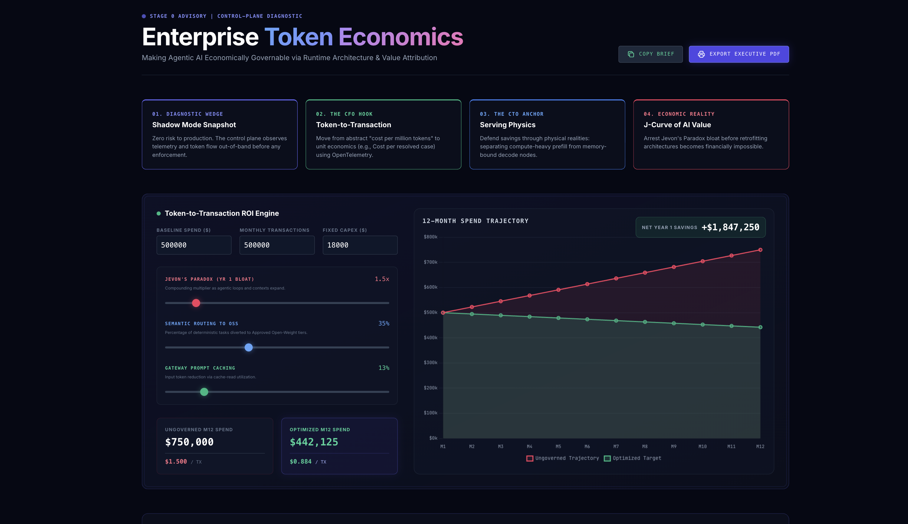
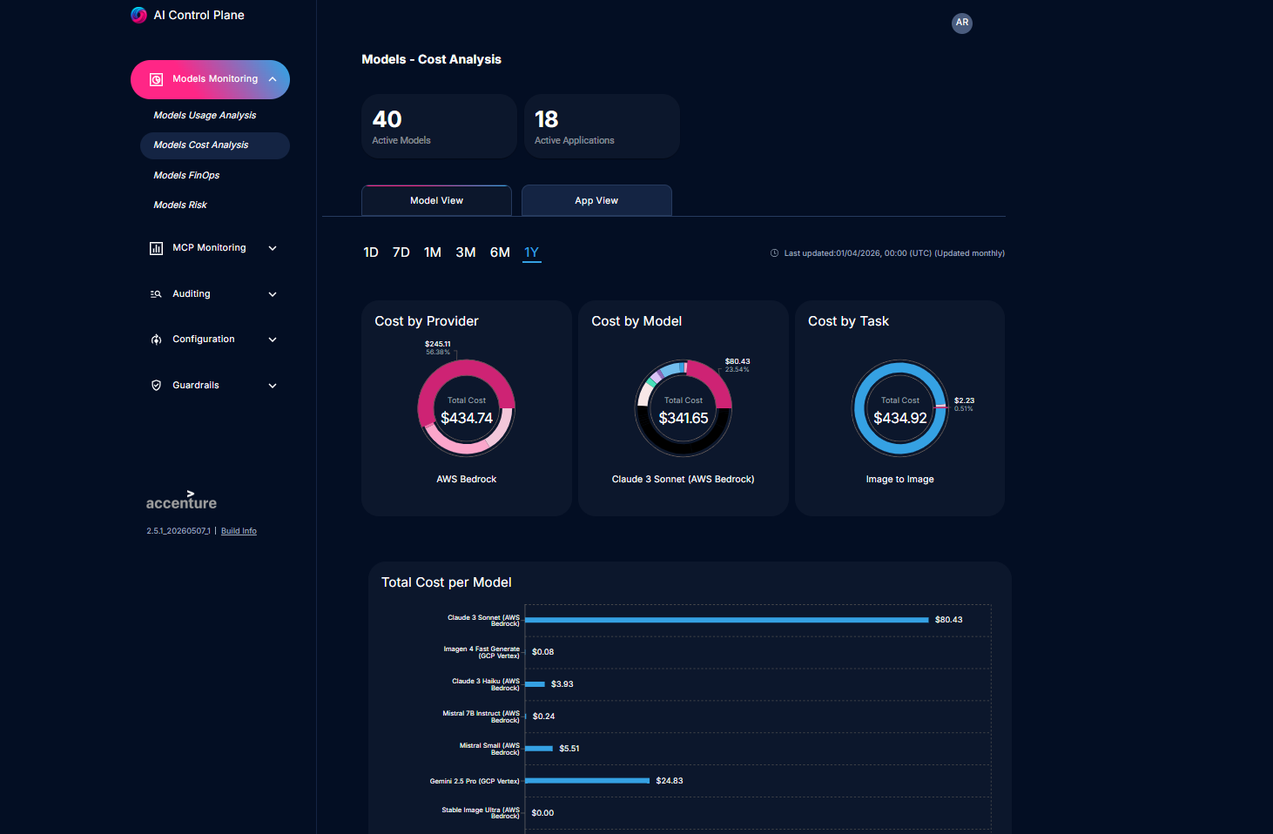
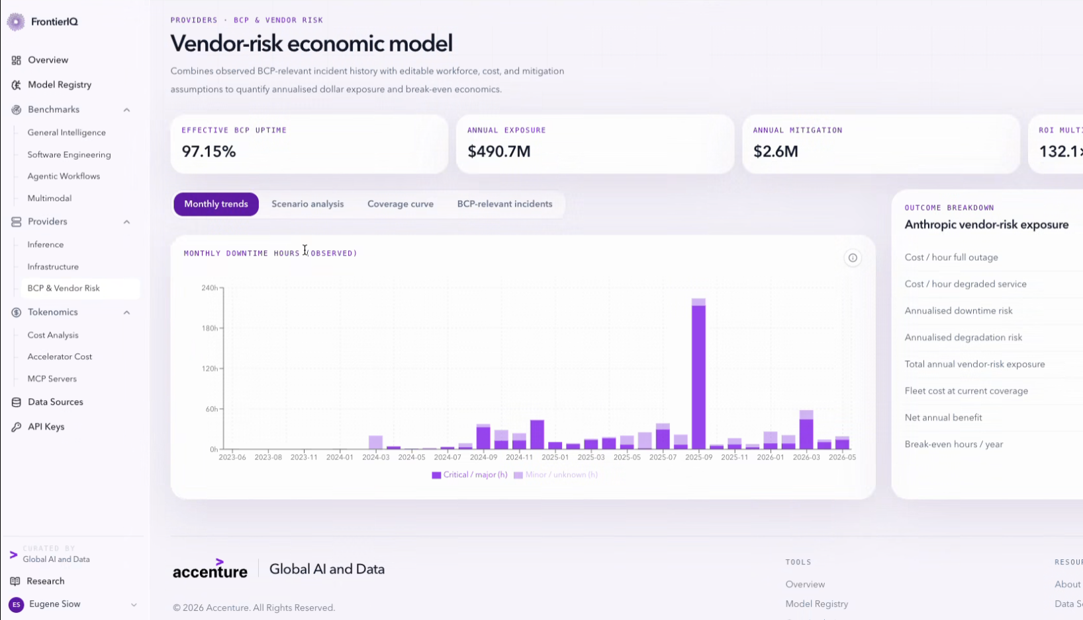
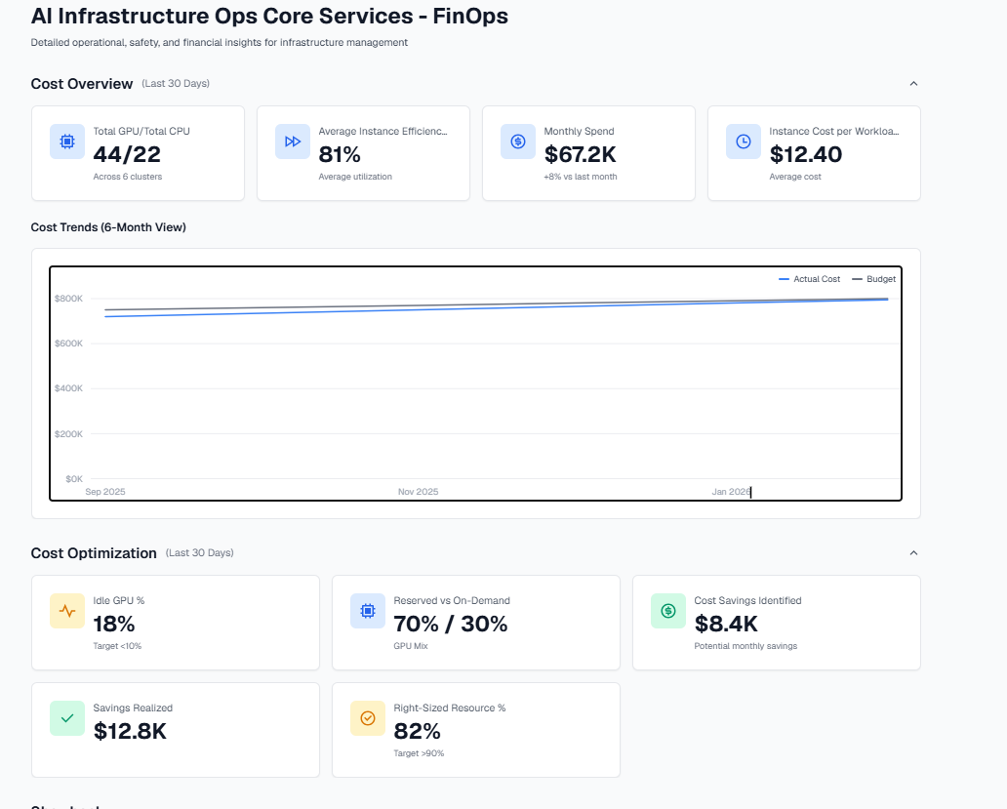
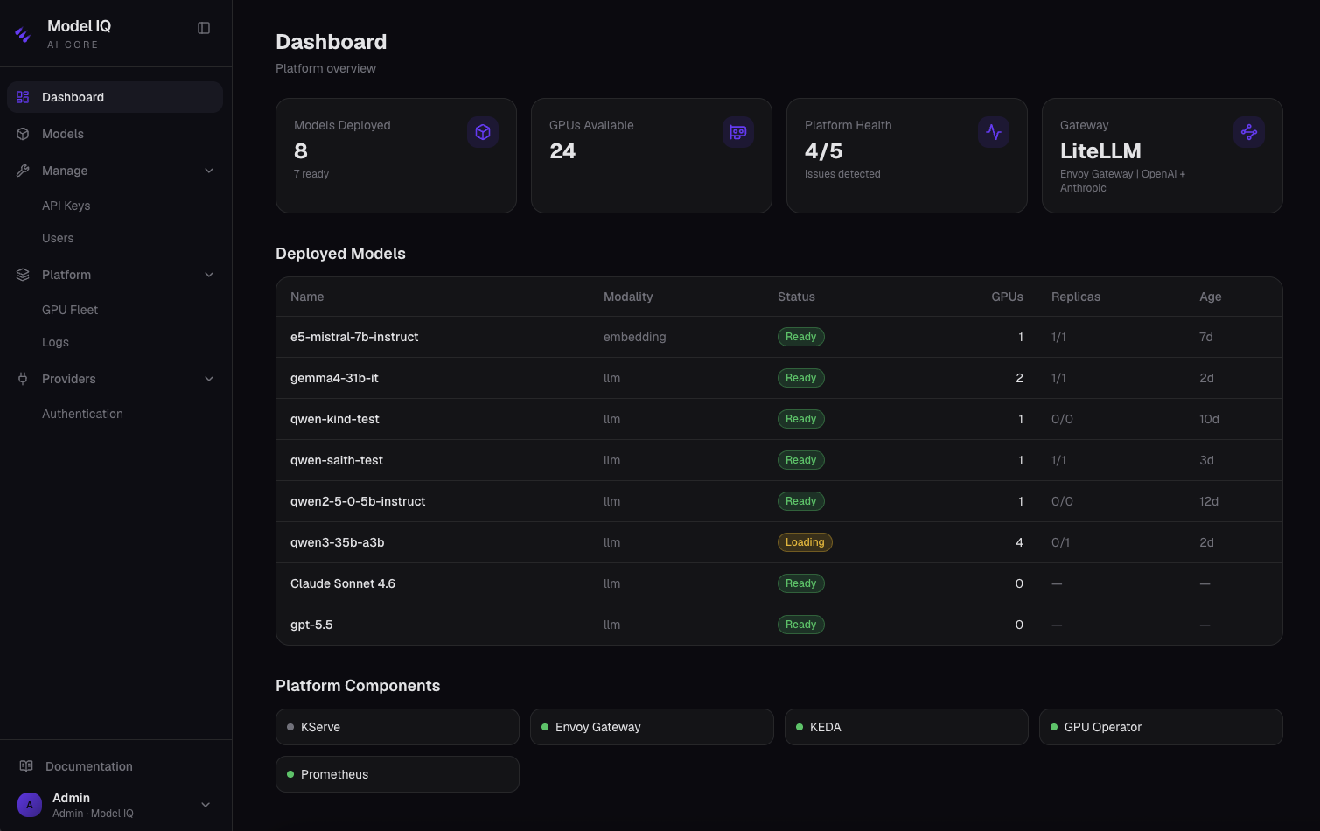
Six purpose-built assets behind our engagements.
Our assets cover design-time benchmarking, runtime monitoring, and FinOps governance.
Token ROI Engine
The math. Quantifies cost ratio per workload. Surfaces Baseline / Jevons-Active / Optimized states. Outputs Cost per Business Transaction.
AI Control Plane
Production observability. Performance, drift, cost per call across every model. Per-MCP-server visibility. Per-workflow budgets at runtime.
Frontier IQ
656 models, 100 providers, 6,226 GPU SKUs, 11 benchmark families. Refreshed continuously. API-first and agent-consumable.
FinOps Cockpit
Unified spend management. Three lenses: Infrastructure Ops, AgentOps, ModelOps. Real-time financial visibility.
Model IQ (part of AI Core)
Sovereign-inference stack. Self-hosted open-weight inference for owned GPU. vLLM paged attention cuts KV cache VRAM 40-70%. Air-gap operations.
AI Knowledge Repository
Curated patterns. Prompt caching, progressive disclosure, inter-agent memory, LLM vs. SLM, self-hosted vs. managed. Surfaced in the IDE.

Slide 13
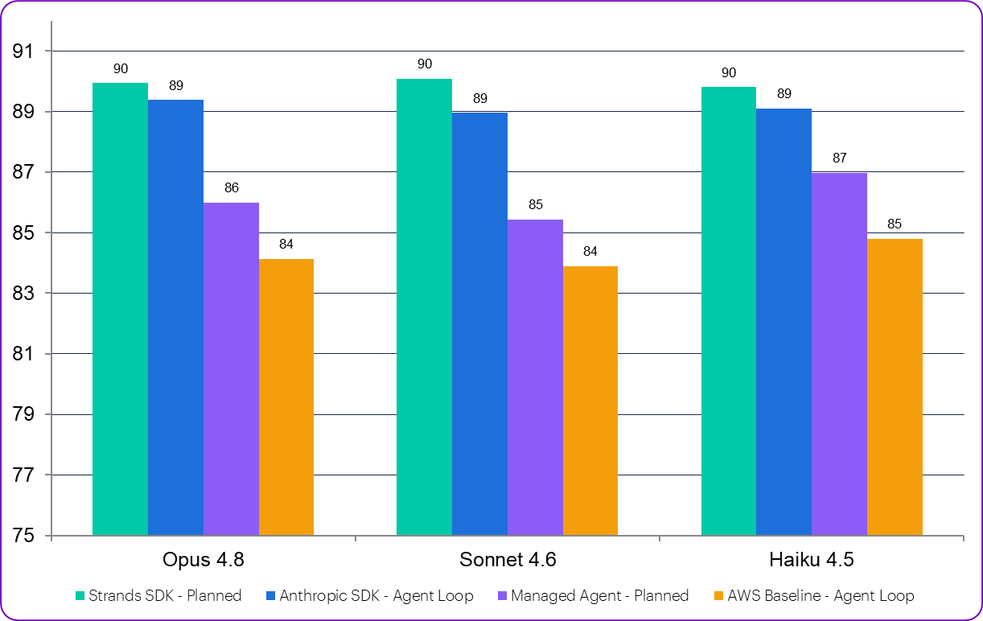
We continue investing in key tools for all steps of execution
Tools that enable our methodology continue to emerge and evolve.
AI discovery questionnaire
Information about providers, models, tools, seats, billing paths, observability maturity and budget owners.
Cost Baseline & Impact Dashboards
Dashboards showing cost by provider, model, and app; daily/weekly trends; and token category breakdown
Billing data extraction scripts
Pre-built scripts for every major provider API. Normalizes output into a common schema — date, model, token breakdown, cost, application tags.
Session Profiler
Plots token cost per turn over session lifetime. Identifies quadratic cost growth sessions, calculates optimal session length, and quantifies savings from session hygiene practices.
Design Playbooks
Prompt optimization, caching strategy, infrastructure optimization, model customization recipes, context engineering
Benchmarking Harness
Customization test harness, pre-defined metrics, benchmarking dashboards

Slide 14
03 | Engagement model

Slide 15
Fast-start entry: identify where TokenOps can create value
We meet clients where they are today.
From a 60-minute discovery to managed operations, every path follows the same logic: evidence-led, design-to-build, value-realized.
.
60-minute conversation
FAST-START PATHWAY
Discussion Topics
Where are AI costs rising or poorly explained?
Which adoption patterns are in scope: tools, APIs, agents, or infrastructure?
What invoices, logs, telemetry, or dashboards already exist?
Who owns cost, quality, risk, and adoption decisions?
What would a credible value case need to prove?
TIER 1 · DISCOVERY WORKSHOP
Identify the entry point
Surface where AI costs are rising or poorly explained. Determine whether workflow concentration justifies a shadow-mode snapshot. Identify who owns cost, quality, and risk.
TIER 2 · BUILD THE FACT-BASE
Comprehensive Assessment
No impacts. Observe token flow and map a baseline cost-per-transaction. Low friction, high evidence. Additional instrumentation may be needed.
TIER 3 · MVP IMPLEMENTATION
TokenOps MVP
Identify priority quick win high impact changes. Convert fact-base findings into a deployable design build. Optimize for architectural as well as application specific inefficiencies. Setup TokenOps for scale and continuous improvement .
Audience
CFO / finance sponsor
CIO / CTO / Chief Data & AI sponsor
AI platform or engineering owner
FinOps / cloud economics lead
Security, risk, or governance representative
Product or business workflow owner
TIER 4 · ENTERPRISE PROGRAM
Scale & Operate
Incorporate high impact architectural changes. Complete monitoring setup. Move into managed operations with continuous tuning, governance, and gain-share. Modular delivery options from managed services to client operated.
Notes:
Services = advisory, arch,

Slide 16
04 | Client credentials

Slide 17
AI & Data Token Optimization Services
Credential proof: TokenOps changes AI economics.
Four examples show the same method: identify the pattern, pull the right lever, measure the result.
Large telecom operator
Global bank
AI as Managed API
AI as Managed API
What the section needs to prove
Query caching, agent triage, dynamic chunking
Inter-agent context control
- We know where AI cost leaks occur.
- We have a lever library by adoption pattern.
- We can quantify savings without slowing adoption.
$12M -> $3.8M
842M tokens saved daily
Mining + insurance
Accenture internal platform
Use these as proof points, not a logo parade.
End-user + managed API
Self-hosted infrastructure
Semantic and model-layer caching
Open-weight inference on owned GPU stack
~40% token reduction
8.7T tokens/week
Copyright(c) 2026 Accenture. All rights reserved. Accenture Confidential
23

Slide 18
How a large telecom operator took $8M out of agentic AI spend without changing a single business workflow.
WORKLOAD
Agentic AI system at a large telecom operator. Production conversational and operational agent flows on managed-API tier.
BEFORE-STATE
Annual token spend had grown to $12M. Architecture was not built for agentic load. Query patterns repeated, agent flows fanned out without triage, context windows grew unchecked. Token ROI Engine simulation would have placed this estate in BREAKS-CASE territory.
TECHNIQUES
(1) Query caching at the application layer for semantically similar requests. (2) Agent triage to route simple queries to lighter agents. (3) Dynamic chunking and compression of context payloads.
OUTCOME
Input-token volume reduced 70%. Annual token spend: $12M to $3.8M. Business behavior unchanged.
GENERALIZES TO
Pattern B (Managed API) agentic workflows in customer service, claims processing, or any multi-agent routing topology.

Slide 19
How 5,000 KYC-AML cases per day got cheaper, without touching the business flow.
WORKLOAD
Global bank, KYC-AML compliance, agentic workflow. 5,000 cases per day. Each case retrieves large volumes of context from proprietary credit data and web-intelligence feeds.
BEFORE-STATE
A constellation of specialist agents. An orchestrator plus ~10 named agents (KYC-SOW Critical Thinker, Evaluator Super Agent, Quality Evaluator, Factual Integrity, Readability & Interpretability, Plausibility, KYC Flow Super, KYCSOW Analyzer, Coherence Write-Up, Coherence Analyzer). Each downstream agent received full context from upstream. Redundant token-passing dominated the bill.
TECHNIQUE
Optimized inter-agent memory passing: restructured the flow so each downstream agent receives only what it needs from upstream. Established business flow preserved end-to-end.
OUTCOME
840 million input tokens + 2 million output tokens saved daily. ~$20K/month saved on a single agentic use case. Quality unchanged; business flow unchanged.
GENERALIZES TO
Claims processing, customer service, code review, underwriting, clinical decision support. Anywhere a multi-agent flow is re-passing context that downstream agents don't need.

Slide 20
Two enterprises. Two caching strategies. Forty percent off the bill with zero quality impact.
WORKLOAD A · MINING
Operational query workflows where employees ask semantically similar questions across shifts and regions.
TECHNIQUE A
Application-layer caching in Redis. Semantically similar prompts served from cache, bypassing the LLM entirely.
WORKLOAD B · INSURANCE
Customer-conversation transcript analysis where each call required a long static pretext prompt prepended to a unique transcript.
TECHNIQUE B
Model-layer caching of the static pretext prompt. Processed once at the model layer; only the unique transcript portion processed per call.
OUTCOME
~40% reduction in token consumption without quality degradation. ~$5K/month combined savings.
GENERALIZES TO
Any high-volume workload where queries cluster around semantic similarity or a long static prefix is prepended to many short variable bodies.

Slide 21
How Accenture's own AI-as-a-Service platform serves 8.7 trillion tokens per week at one-sixth the cost of frontier APIs.
WORKLOAD
Accenture's internal AI-as-a-Service platform, serving 77,000-strong Data & AI population. Heavy agentic and automated-pipeline workloads.
BEFORE-STATE
Center for Advanced AI data: 1,006 users, 249 billion tokens, $472K spent in just four months (Jan-April 2026), trajectory to double the annual run rate before Q4. Workspace limits suppressed an even steeper curve. The reflex would have been to throttle. Instead we built our way out.
TECHNIQUE
Self-hosted open-weight inference at scale. Models: GPT-OSS and Llama. Hardware: Nvidia H100. Accenture-tuned inference stack delivers ~2x throughput vs. baseline vLLM across all prompt-length categories.
OUTCOME
8.7 trillion tokens per week served on owned infrastructure. Monthly infrastructure cost: $300K. Equivalent at Claude Sonnet 4.6 token pricing: $51.6M/week.
DOWNTIME RISK
At 99.5% uptime, extrapolated to 77,000 users: $5M/hour lost productivity; $154M annualized. Sovereign inference closes this exposure.

Slide 22
05 | TokenOps Levers

Slide 23
Revisit enterprise AI architecture
Re-architecture Target
Critical architectural areas impacting token proliferation and optimization
AI Control Plane
AI
Orchestration
AI Operations
Multi-Agent Orchestration
Agent Memory
Tool Integration
No Code Agents
Agent Eval
Agent/Model/Tool Certification
Embedded Agents
Agent Generation
AI Telemetry Integration
Agent/Tool/Model Registries
AI
Reasoning Hub
Foundation Model Adaptation
Experiential Learning
LLM and Multi-modal Inferencing API
Model Benchmarking
Classical ML/DL Training & Serving
AI Integration Gateway (A2A, MCP, Model)
Agent/Model Security & Access Controls
AI Observability (FinOps, Safety, Usage)
Knowledge
Fabric
Knowledge Metadata Integration
Skills
Curated Ontologies
Vector Search
(Semantic) Knowledge Retrieval
Transparency & Audit Logging
AI DevOps (AgentOps, ModelOps, PromptOps)
Knowledge Graphs
Human Intervention
Data
Foundation
Vulnerability Management
Structured Data Supply Chain
Streaming Data Supply Chain
Structured Data Products
Streaming Data Products
Data Management
AI Guardrails & Policies
Unstructured Data Supply Chain
Synthetic Data Supply Chain
Vectorized Data Products
Synthetic Data Products
Confidential Compute
SIEM Integration
AI Systems Registry
Compute Infra
Cluster & Server Infrastructure
Container Management
Network Management
I&AM
Multi-Tenant Topology
Platform Operations
Serverless Infrastructure
Storage Management
HA & DR

Slide 24
Revisit AI application architecture and design
1
2
3
4
9
10
11
12
Input
Craft Prompt
Input Guardrails
Call LLM
Output
(user/batch request)
(PII detection, topic denial etc.)
(LLM response)
Fetch Context
Prompt Registry
(via AI gateway)
5
6
7
8
Must have design considerations
1
Intent routing & early rejection
5
Re-rank + smaller top-k
9
Model routing & cascading
2
Prompt caching by design
6
Context pruning / compression
10
Batch API
3
Prompt compression
7
Code Mode
11
Output token control
4
Tiered guardrails
8
Context Caching
12
Output guardrails w/o regen loops

Slide 25
Examples of our advanced engineering levers
Coming off our deep research and expertise in this space
Memory Management
Cache Optimization
Context Optimization
Context Pruning
Compact, structured context that contains the right information at the right granularity — not a bloated chronological dump of everything that's happened. This means fewer input tokens consumed per request, better cache alignment (the tree structure stays relatively stable), and higher quality responses because the model isn't distracted by irrelevant history.
Eliminate up to 96% of the time-to-first-token by skipping straight to answering — the heavy encoding work was already done and cached. You're not reducing the number of tokens the model sees, you're eliminating the redundant cost of processing the same tokens repeatedly across requests. Combined with cache compression, it also reduces the storage and memory overhead of keeping these pre-built caches around.
Enable reuse of context what agent A already discovered (if permissions allow), eliminating redundant token consumption across the agents in the organization. The permission-aware filtering also means agents don't waste context window space on information the user isn't authorized to act on — every token in context is both relevant and permissioned.
Instead of context growing linearly (or worse) with every step — meaning step 50 replays the full history of steps 1–49 — the working context stays bounded at a fixed size regardless of how long the task runs. The agent only pulls in exactly the evidence it needs for the current step, uses it, and releases it. Every token in the active context window is earning its keep.
The theoretical result is significant: Memex can preserve decision quality with bounded context size even as task history grows unboundedly, as long as the number of retrievals per step stays bounded.
MemTree
Proprietary algorithm contributed by Accenture research.
KVLink
Proprietary algorithm contributed by Accenture research.
Collaborative Memory
Proprietary algorithm contributed by Accenture research.
MemEx (RL)
Proprietary algorithm contributed by Accenture research.

Slide 26
Examples of our asset-driven levers
Design it right from day one
Rapid Opportunity Sizing
Cost Optimization Design
Semantic Routing
FinOps & Continuous Monitoring
Baseline spend, diagnose leakage, quantify value, and rapidly quantify opportunities to optimize AI costs.
Implement priority levers, tune controls, and prove early savings.
Deploy gateway rules, dashboards, routing, caching, and operating routines.
Run continuous visibility, governance, tuning, recommendations, and reporting.
Enabling Technologies
Enabling Technologies
Enabling Technologies
Enabling Technologies
Token ROI Engine
The math. Quantifies cost ratio per workload. Surfaces Baseline / Jevons-Active / Optimized states. Outputs Cost per Business Transaction.
frontier-iq
Live intelligence across 656+ models and 100+ providers to inform every model selection, routing, and cost decision.
Model-iq
Right-sized models on your hardware. Smart routing keeps routine tasks on-prem; no inference leaves your network.
FinOps Cockpit
Unified spend management. Three lenses: Infrastructure Ops, AgentOps, ModelOps. Real-time financial visibility.

Slide 27
Our catalog of optimization levers (1/3)
# | Strategy | What it does | How to implement
1 | Intent routing & early rejection | Cheap classifier routes/filters requests before any costly token is spent; dedup repeat queries. | Embedding or small-model router → route table; hash-dedup identical inputs; drop out-of-scope early. Block denied topics
2 | Prompt caching by design | Structure the prompt so the stable prefix is cached and re-read at a deep discount. | Static first (tools→system→few-shot), dynamic last; verify cache_read tokens.
3 | Prompt compression | Cut low-information tokens from instructions & few-shot while preserving meaning. | LLMLingua/LongLLMLingua at tuned ratio; trim few-shot to minimum; distill redundant instructions; A/B for quality.
4 | Tiered guardrails | Replace large-LLM moderation with cheap checks for the common case. | Regex/rules first (0 tokens) → small classifier (e.g. Llama Guard) → escalate only ambiguous cases; run before the big LLM.

Slide 28
Our catalog of optimization levers (2/3)
# | Strategy | What it does | How to implement
5 | Rerank + smaller top-k | Over-fetch candidates, then rerank and inject only the few best chunks instead of stuffing top-k. | Retrieve 50–100 → cross-encoder rerank (Cohere Rerank / bge-reranker / FlashRank) → keep top 3–5; tune chunk size 256–1024.
6 | Context pruning / compression | Shrink retrieved chunk text before injection; prefer extractive (verbatim) for high-stakes. | Lang Chain ContextualCompressionRetriever + Metadata filter (e.g.; filter by topic, role etc.)
7 | Code mode https://blog.cloudflare.com/code-mode-mcp/ | an innovative AI agent technique where, instead of forcing a Large Language Model (LLM) to call individual tools or APIs one by one, the AI writes a single block of code to accomplish the task | Implemented via AI Gateway
8 | Context caching | Cache large, stable knowledge-base / document context so repeated sends are ~90% off. | Put stable docs early in system; mark with cache_control (Anthropic) or CachedContent (Gemini); compress then cache. Gemini models support explicit caching

Slide 29
Our catalog of optimization levers (3/3)
# | Strategy | What it does | How to implement
9 | Model routing & cascading | Easy queries → cheap model; escalate to frontier only on low confidence. | Routing strategies via LLM gateway like Litellm or Kong
10 | Batch API | Async bulk jobs get a flat 50% discount on input + output. | Anthropic Message Batches / OpenAI Batch (JSONL); plan for up to 24-hr window; stacks with caching.
11 | Output token control | Cap and shape generation — the highest-leverage knob (output 5–6× input). | Set max_tokens; native structured output / JSON schema; stop sequences; prompt for terse output / IDs not prose.
12 | Output guardrails w/o regeneration loops | Validate output without triggering wasteful full re-generations. | Constrained decoding prevents malformed JSON; partial/field-level re-prompt (Guardrails AI); watch false-positive math.
Apply configurable ReACT loop to prevent unbounded compute and token usage

Slide 30
Prompt analytics as a key optimization lever
Order Management
Prompt Analytics
Prompt Analytics Dashboard
CANCEL ORDER
XXXXX
What are the top 10 expensive interaction topics?
→ Candidates for optimization
ORDER DELAY
XXXXX
XXX
ORDER DELAY
WISMO
XXXXX
ORDER DELAY
XXXX
What are the top 10 expensive prompts?
→ Candidates for optimization
ORDER DELAY
Are there topics that should not be answered by the LLM/Agent
→ Improve Topic Denial Guardrail
Prompt | # of tokens | Date
Where is my order | 1000 | 09-09-1025
I am not able to find my order | 10000 | 09-09-1025
My order is not traceable | 2000 | 09-09-1025
I am not finding my order | 4000 | 09-09-1025
I am not finding my order | 4000 | 09-09-1025
I am not finding my order | 4000 | 09-09-1025
I am not finding my order | 4000 | 09-09-1025
Which set of prompts are constantly providing wrong answers?
→ Don’t pay for inefficiencies
What is the memory usage while answering the prompts?
→ More memory/Less cost

Slide 31
Thank You

Slide 32
Key contacts

